Slide 1

Raspberry Pi 201 More Fun with Pi
By Chuck Duey
September 19th 2018
TM Raspberry Pi Foundation www.raspberrypi.org

Slide 2
Outline:
TM Raspberry Pi Foundation www.raspberrypi.org
Tips and Tools for the Raspberry Pi
Somethings the Raspberry Pi can do with USB hardware
Wireless router/Access point
Software Defined Radio…Show FM and TCAS
Sockets and communications
Raspberry Pi Addon Hardware
Built in interfaces for camera and display
Hats and bonnets
Other Addon Boards
Detailed tour of the I/O ports and how to connect.
GPIO Relay and Buttons…Raw Linux, Python.
I2C Devices. Look at display and EEPROM
I2C Devices Look at Pressure sensor 4 ways. Linux, Python, smbus and MRAA.
Look at SPI compare SPI to I2C.
ADC to Display.

Slide 3
Difference between the Raspberry Pi Versions
Model | Zero/W | B | A+ | B+ | Pi 2 | Pi 3 | Pi 3+
CPU | Arm 6 1000MHz | Arm 6 700MHz | Arm 6 700MHz | Arm 6 700MHz | 4xArm 7 900MHz | 4xArm 8 1200MHz | 4xArm 53 1400MHz
RAM | 512MB | 512MB | 256MB | 512MB | 1GB | 1GB | 1GB
USB | 1 | 2 | 1 | 4 | 4 | 4 | 4
Network | None/WiFi | 10/100 | None | 10/100 | 10/100 | 10/100/WiFi | 10/300/WiFi
Video | HDMI | HDMI/NTSC/PAL | HDMI/NTSC/PAL | HDMI/NTSC/PAL | HDMI/NTSC/PAL | HDMI/NTSC/PAL | HDMI/NTSC/PAL
Hardware IO | 25 | 17 | 25 | 25 | 25 | 25 | 25
+5V Current | 120mA | 350mA | 140mA | 250mA | 350mA | 480mA | 600mA
Bluetooth | Yes/W | No | No | No | No | Yes | Yes
SD Card | Micro | Mini | Micro | Micro | Micro | Micro | Micro
Cost | $5/$10* | $30* | $20 | $25 | $35 | $35 | $35

Slide 4
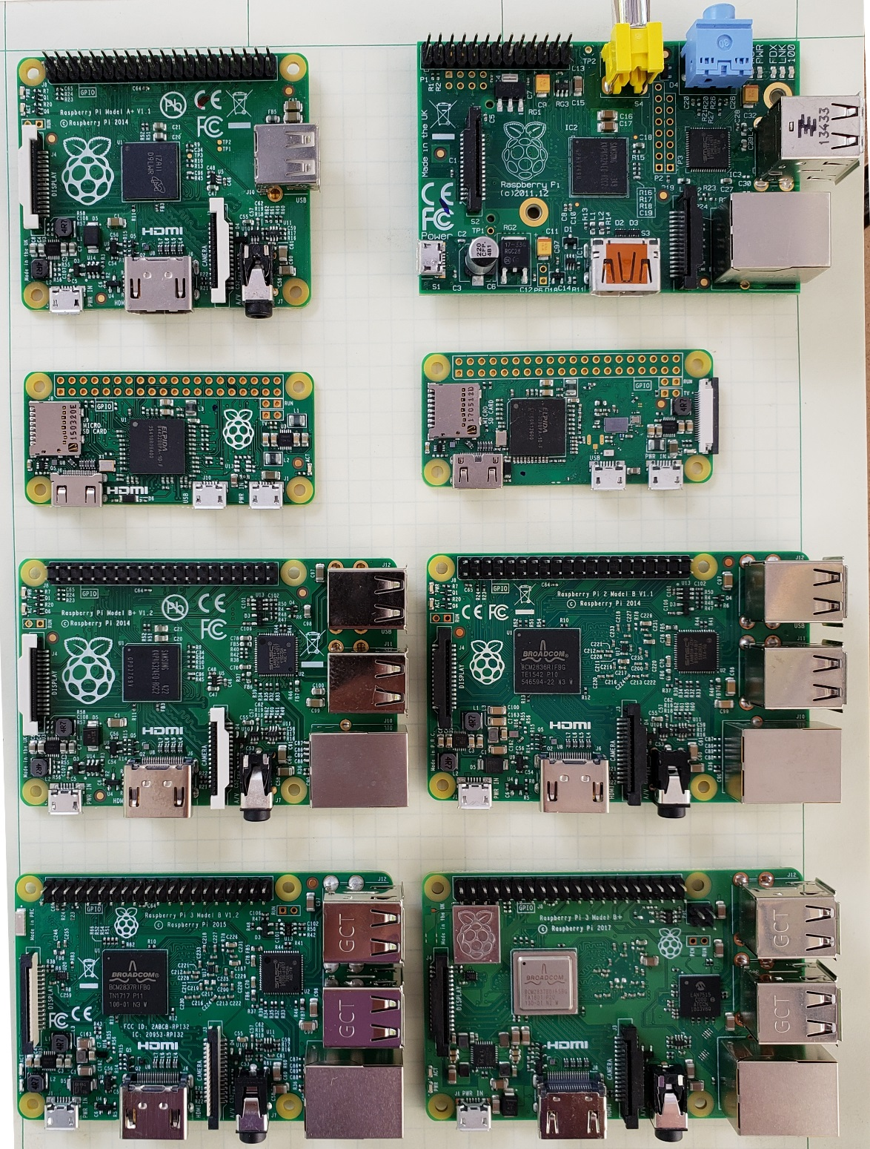
A+
B
Zero
Zero W
B+
Pi2
Pi3
Pi3+

Slide 5

Some Raspberry Pi Resources
TM Raspberry Pi Foundation www.raspberrypi.org
Good Links and web sites:
www.raspberrypi.org —The Foundation’s Website
www.raspberrypi.org/downloads — Various Raspberry Pi Operating Systems
www.adafruit.com — Adafruit very good site for parts and tutorials
learn.adafruit.com/category/raspberry-pi —Many projects and how to’s at Adafruit
www.sparkfun.com —Raspberry Pi parts and many other Hobby parts. (Colorado Co.)
www.mcmelectronics.com —Low priced Raspberry Pi Parts
www.microcenter.com —Online and In Store Raspberry Pi
http://www.instructables.com/howto/Raspberry+Pi/ Lots of good Pi Tutorials
https://github.com/Chuckduey/CSU_Pi_Class.git GitHub page with the code from this class.
My email cduey@msn.com

Slide 6
Important Raspberry Pi Tips
Do Not add or remove hardware while running. Including USB devices. Plugging in a mouse at the last minute can kill the SD card.
Power down the Raspberry Pi using a software command before removing power. SD corruption is very common on uncontrolled power downs.
SD cards are fragile and also wear out. Keep a backup copy of your code. It is best to store it on a network drive.
SD cards come in various speeds and sizes. Class 10 is the fastest. For the Raspberry Pi 32GB is the maximum sized. (SD limitation)
The Raspberry Pi I/O ports are 3.3V. A 5V signal will render the port, and possibly the whole Pi useless.
The Micro SD cards are very easy to pop out accidentally. If it does while it is running, resist the temptation to plug it right back in. Power down first!!!

Slide 7
Useful Tools
Linux or MAC computer with USB and network.
With a Linux computer, it makes it easy to copy, change and back up Raspberry Pi SD cards using the “dd” command.
Also the ssh, and ssh –X makes it easy to remote in to work.
Win32 Disk Imager - A perfect tool copying and backing up Raspberry Pi SD cards. Do not do a direct SD to SD copy.
PuTTY - creates a terminal window that can be used to “ssh” to any Linux computer on you network from a windows machine.
VNC/ RealVNC – VNC can display a desktop to another computer Linux or Windows. Very nice for remote work from different platforms.
USB power 2A or more - While most computers are limited to 500mA of current on the USB port, it is easy to have more that that draw from a Raspberry Pi with accessories.

Slide 8
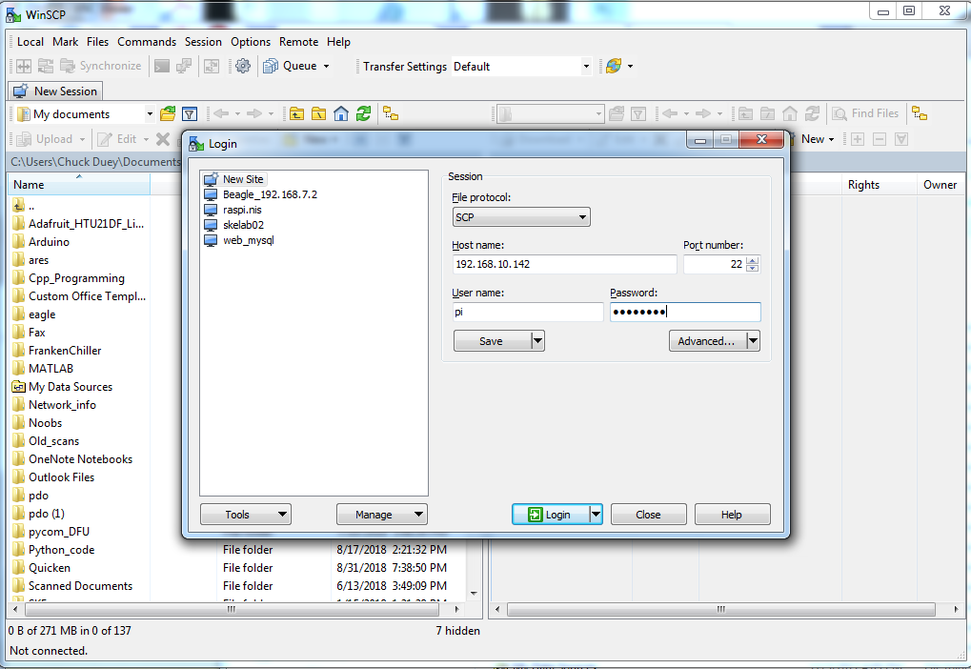
WinSCP File browser between Pi an PC

Slide 9
Terminal window commands
ls = list files in directory ls –l = List long ls –a = List all
cd (dir name) = change directory
df –h = Show file systems sizes and usage
nano (file) = Simple intuitive text editor
vi (file) = Simple powerful non-intuitive test editor.
cat (file) = output the contents of a file
less (file) = output a file one page at a time
apt-get install (package) = get an package to install
apt-get update = update packages
apt-cache show (key word) = show available packages
sudo = next command execute as root
ifconfig = show the ip interface connections

Slide 10
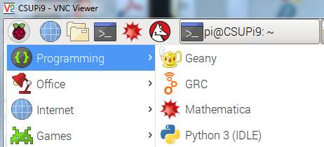
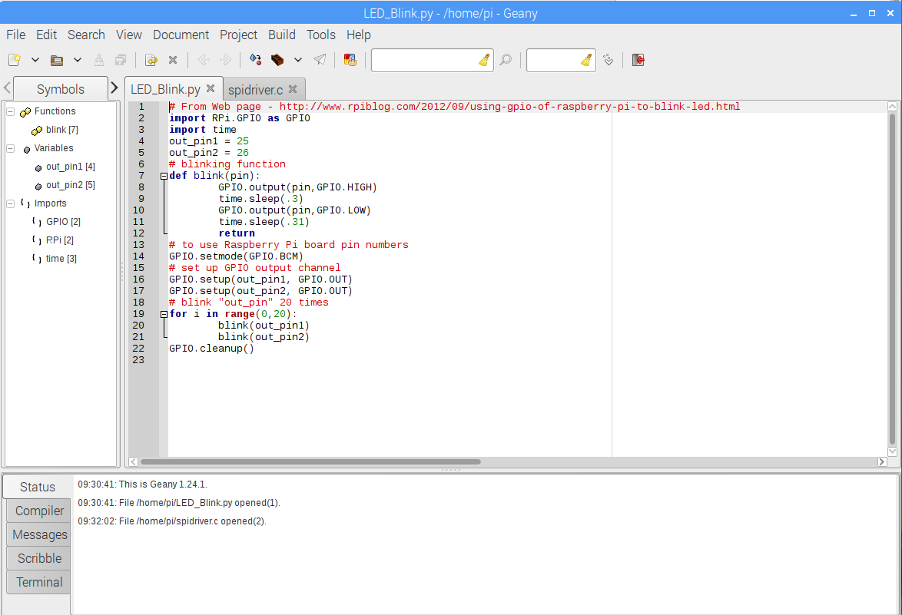
Text Editor with Code Context “Geany”

Slide 11
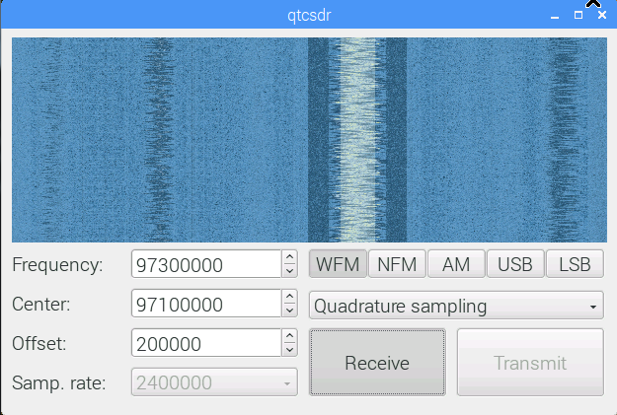
Raspberry Pi SDR (Software Defined Radio)
HA7ILM Multimode Raspberry Pi SDR: git clone https://github.com/ha7ilm/qtcsdr

Slide 12
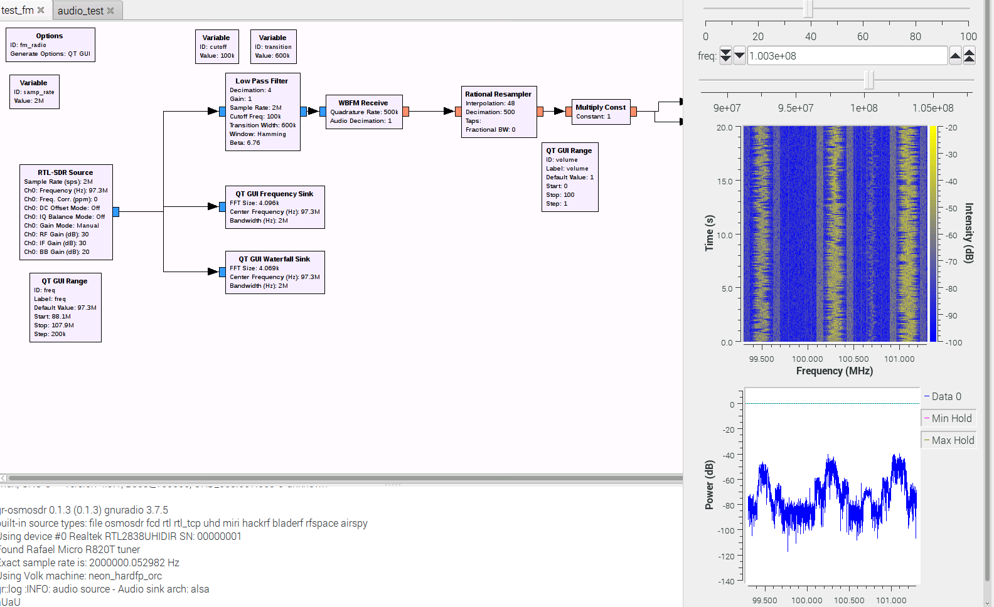
GNURadio Example and Demo

Slide 13
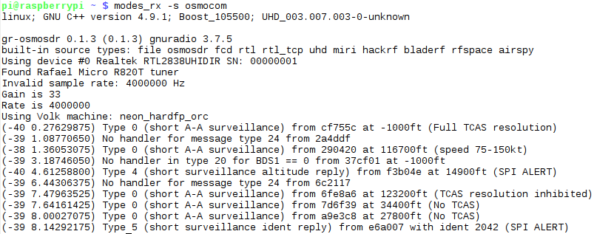
modes_rx –s osmocom
Aircraft TCAS – See if there are any aircraft squawking near by

Slide 14

One more SDR Example Receiving NOAA Satellite Data
http://www.instructables.com/id/Raspberry-Pi-NOAA-Weather-Satellite-Receiver/

Slide 15
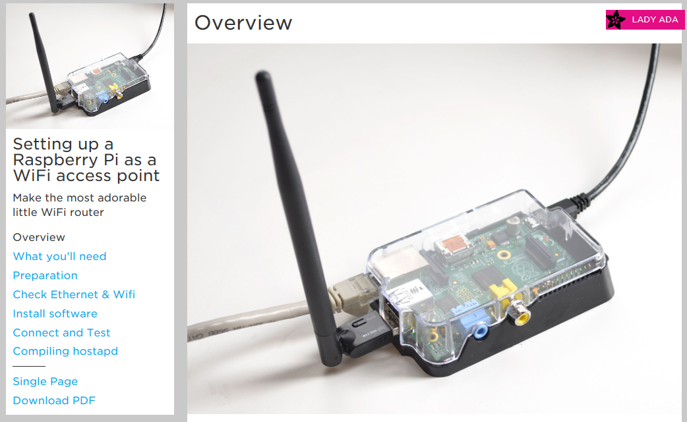
Raspberry Pi as Wireless Access Point
https://learn.adafruit.com/setting-up-a-raspberry-pi-as-a-wifi-access-point?view=all

Slide 16
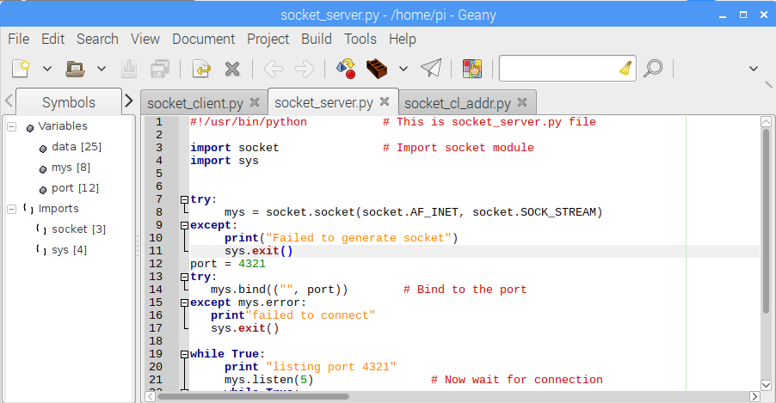
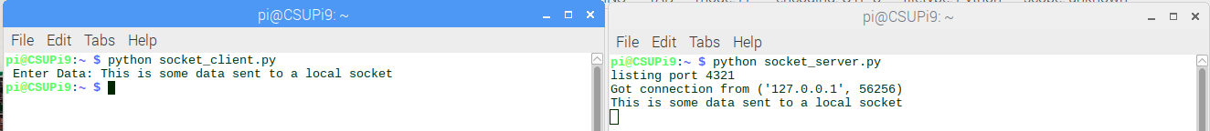
Communicating Via Sockets
In Geany open up socket_server.py, socket_client.py and socket_cl_addr.py
In one terminal start up the Socket Server “python socket_server.py”
In a different terminal run a socket_client.py and send a message.

Slide 17
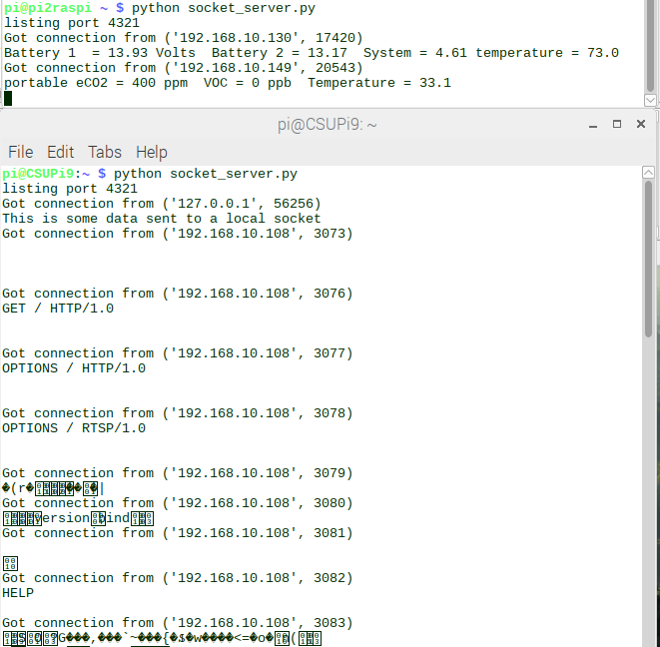
Now for some fun over the LAN
Find your IP address by typing “ifconfig” Trade addresses with neighbors
Then use “python socket_cl_addr.py” to send data to your neighbor.
This is a nmap probe looking at this port.
If there is an open port, be prepared for it to be probed!

Slide 18
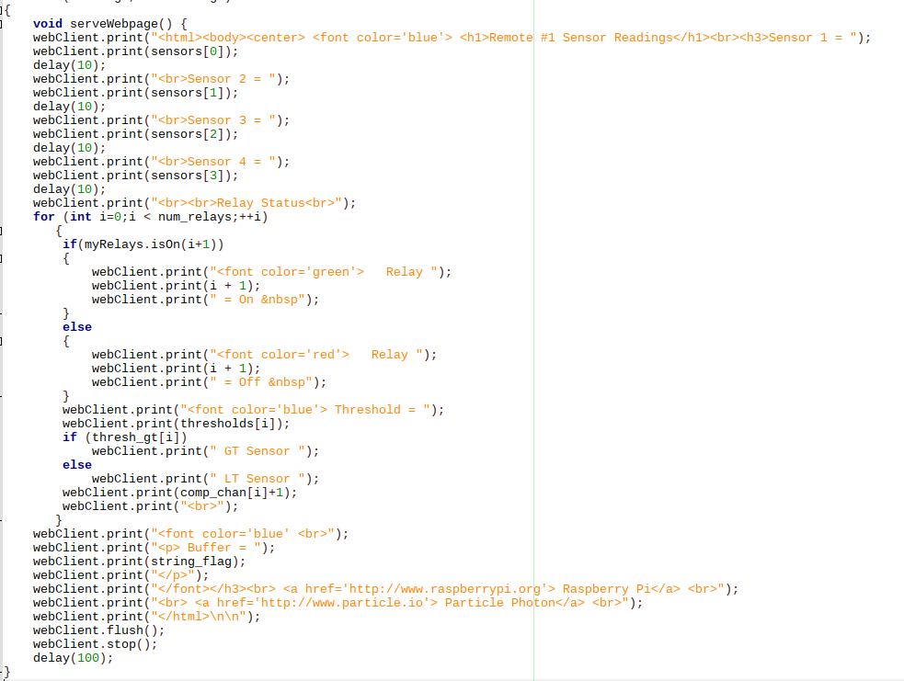
Port “80” AKA http://
With a Get Request Respond with this code:

Slide 19
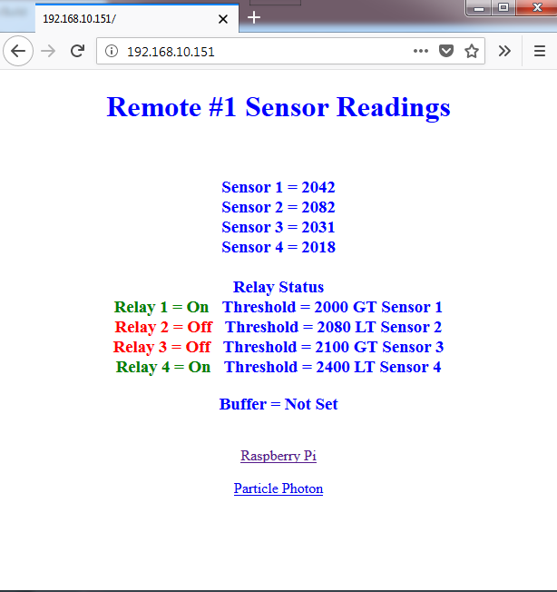
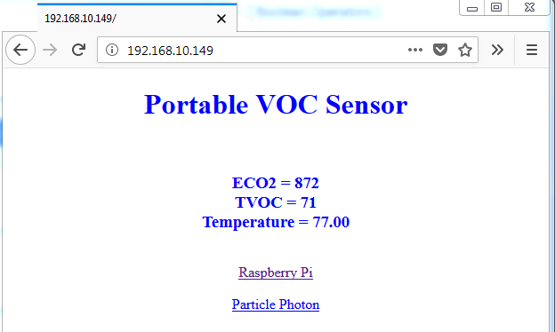
The Web Page will look like this

Slide 20
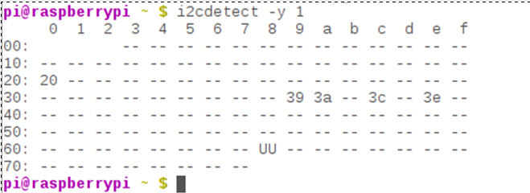
Raspberry Pi I/O*
GPIO
Good for Controlling devices like relays, LEDs etc.
Also can be used as inputs. Can be made to implement bus system.
UART/Serial – 2 Wire interface 3.3V
Good for GPS, RS-232 Monitor, and many others.
Baud rates up to 115200 bps
SPI Serial 4 Wire interface. (MOSI, MISO, SCLK, CE) 3.3V
2 Chip Selects built in. Easy connections to many serial sensors.
Speeds can be between 8KHz to 125MHz
This can be used to run an LCD Screen
I²C Serial 2 Wire Interface. (SDA, SDL) 3.3V
Multiple devices with 7 bit address. Up to 127 - 11
Much slower 400Kbps For Raspberry Pi.
Great for touch screen sensors.

Slide 21
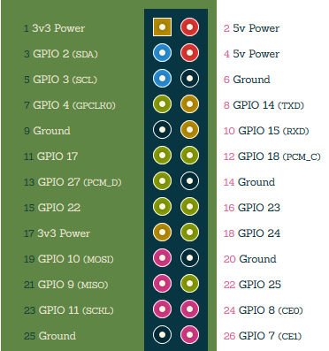
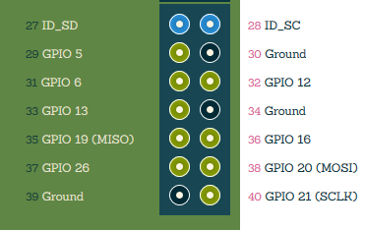
GPIO Pin out*
All Others Extra pins
Note: GPIO pins are 3.3V Only
A 5V input will cause damage to the Raspberry Pi!!!
Pi A and B Pin Out
*From http://pi.gadgetoid.com/pinout

Slide 22
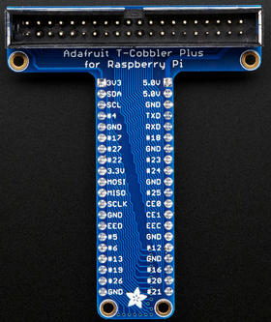
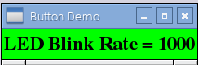
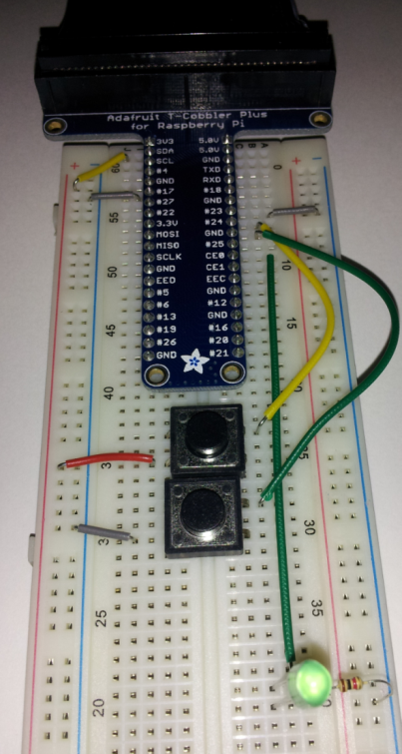
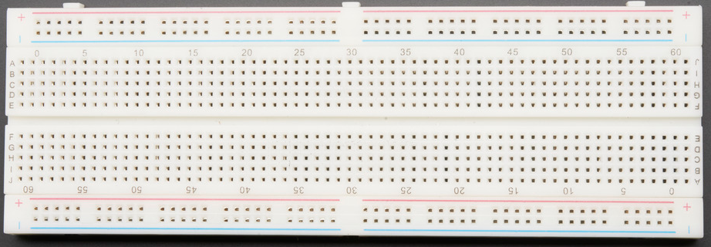
Now For Fun and Games with the Pi

Slide 23
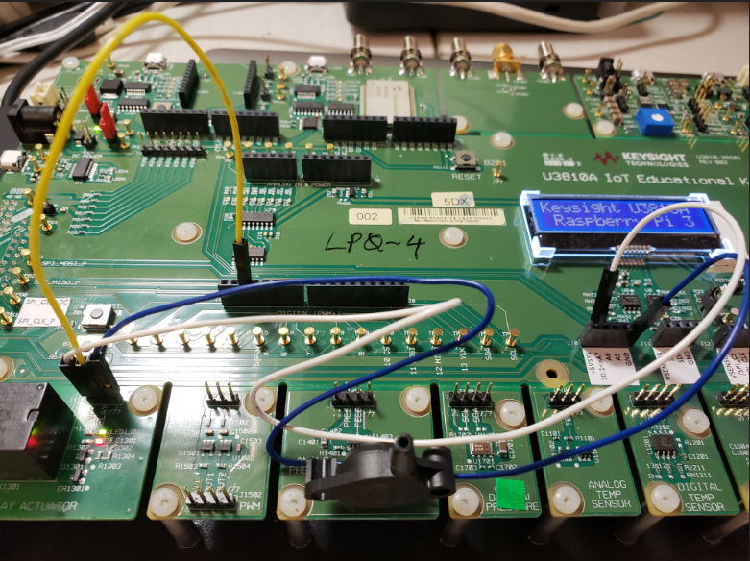
Hook up Relay
Connect Relay to Pin 3 of J9
Connect VDD to +5VSYS on J10, and GND on the same J9

Slide 24
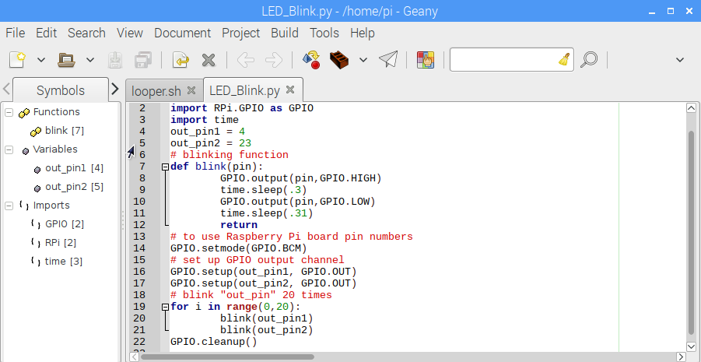
Geany looper.sh and LED_Blink.py
Run “python LED_Blink.py” first then “./looper.sh”

Slide 25
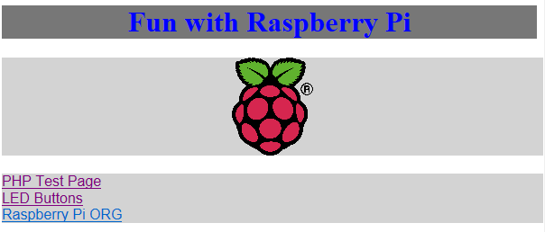
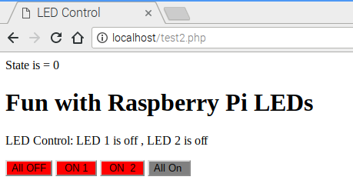
Web Page LED Control
Click Here
Turn on and off your Relay

Slide 26
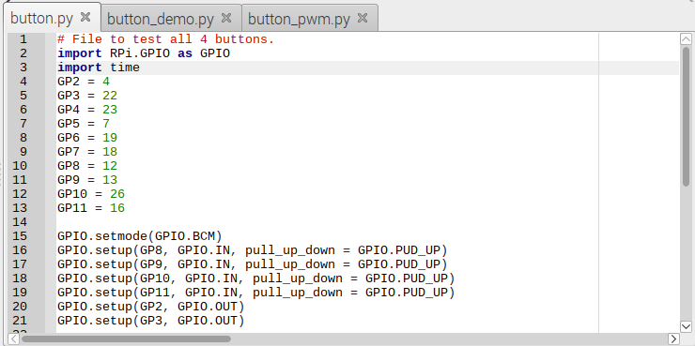
Geany button.py, button_demo.py and button.pwm.py
python button.py - Press buttons….Senses but it is a polling routine
python button_demo.py - Buttons now are set up as events.
python button_pwm.py – Buttons and PWM control of GPIO pins

Slide 27
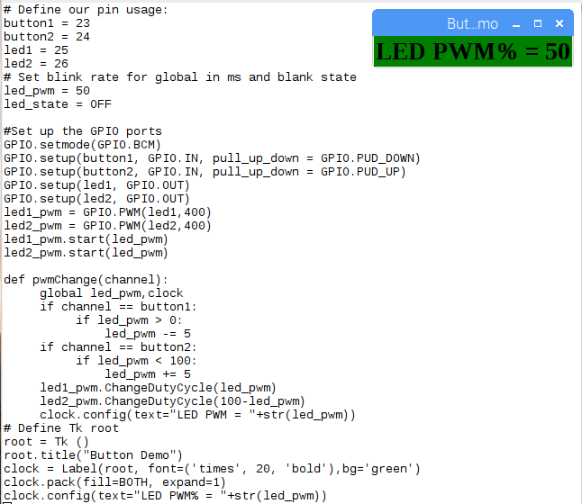
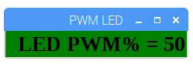
LED Put it all together
python button_pwm.py

Slide 28
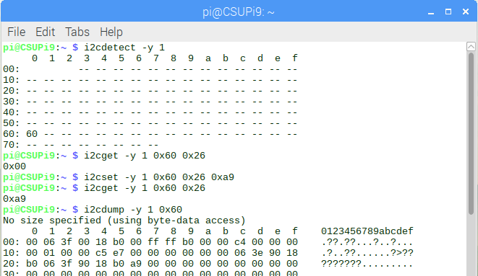
I2C Bus and Tools
The i2c bus is a bidirectional bus with 2 lines SDA and SCL.
This bus can have up to 117 devices.
i2cdetect - Show the devices on an i2c bus
i2cget – read a register value from an i2c device
i2cset – write a value to an i2cdevice.
i2cdump – dump all the values available from an i2cdevice.

Slide 29
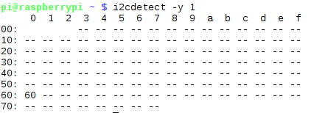
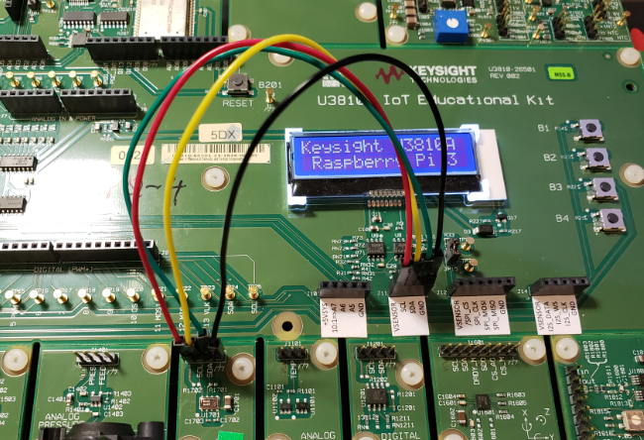
Hook up the I2C Pressure temp sensor
Connect J11 GND to Ground on Pressure sensor
Connect J11 VSENSOR to VDD on Pressure sensor
Connect J11 SCL to SCL and SDA to SDA
I2cdetect –y 1 - You should see if it is correct

Slide 30
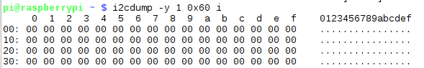
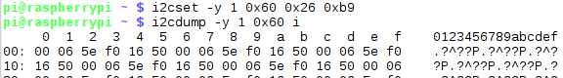
i2cdetect –y 1 – and see if it is hooked up
i2cdump –y 1 0x60 i :look at the values
i2cset –y 1 0x60 0x26 0xb9 :dump again

Slide 31
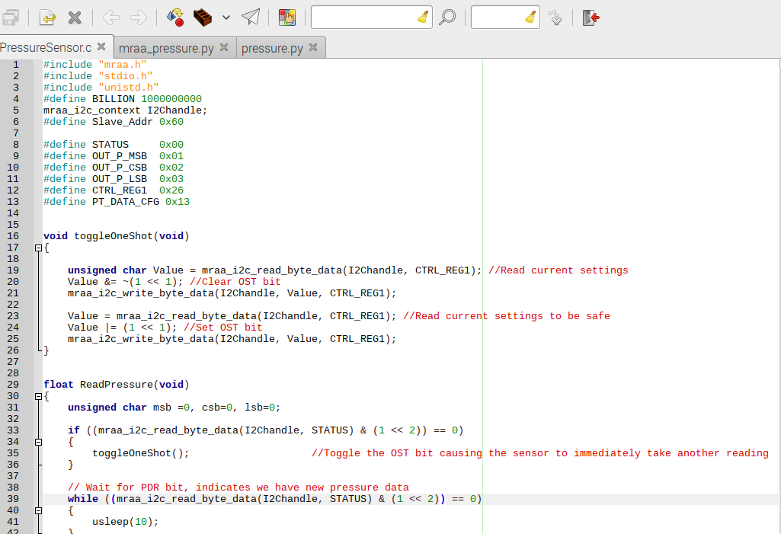
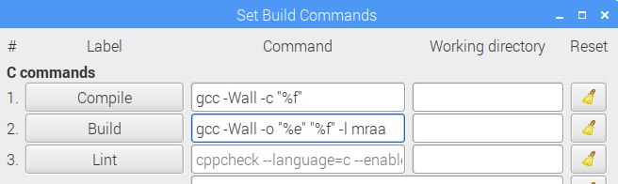
Geany Code/PressureSensor.c pressure.py and mraa_pressure.py
Compile
Make
Run
May have to add –l mraa to build commands
Compile, Make, Run Code/PressureSensor.c
Run pressure.py
Run mraa_pressure.py
The MRAA Libs are more portable across platforms. Same code can run on Pi, BeagleBone, Edison, 96 Boards, etc

Slide 32
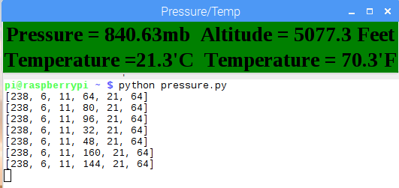
Now try the GUI display Using smbus API pressure.py Using MRAA Libs

Slide 33
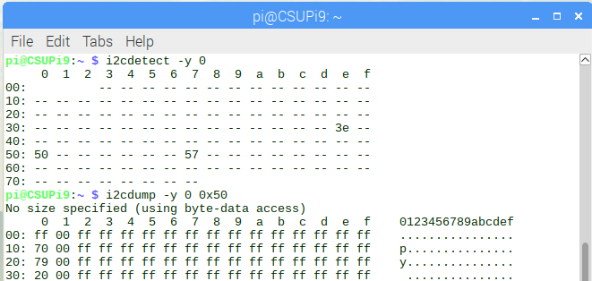
Look at a whole other i2c bus
i2cdetect –y 0

Slide 34
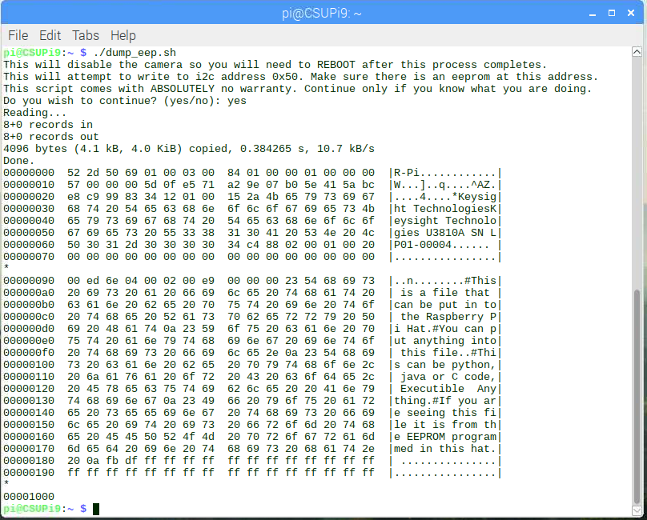
Take a look at the eeprom at 0X50
This device is at /sys/class/i2c-adapter/i2c-0/0-0050/eeprom

Slide 35
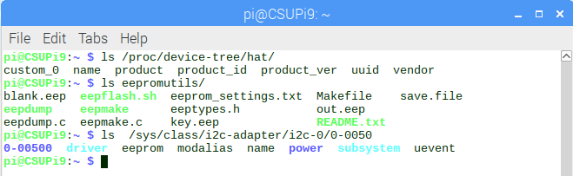
On Boot If Valid EEPROM Information on Hat is available
In /proc/device-tree/hat is all the information put in for the hat.
“cat /proc/device-tree/hat/product” and see your serial number
You can roll your own Hat EEPROM using eepromutils

Slide 36
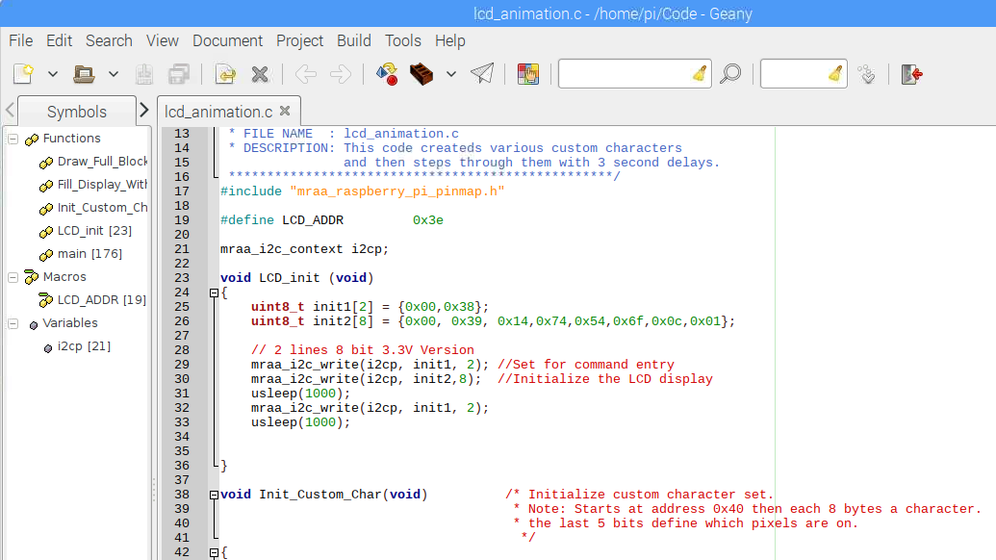
Just for Fun Compile, Link and Run Code/lcd_animation.c with Geany

Slide 37
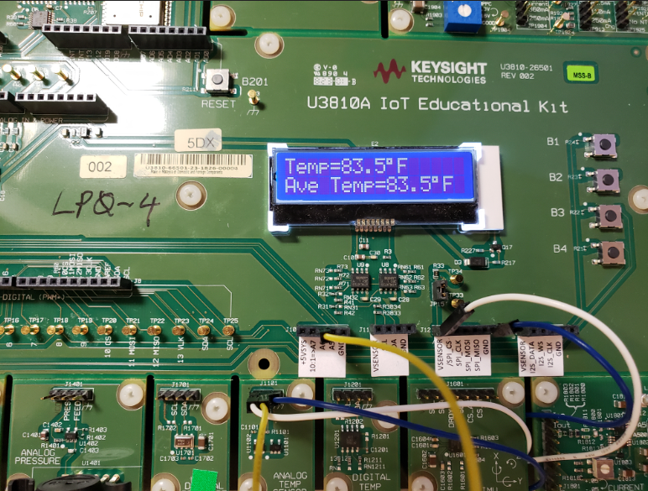
SPI and ADC
The SPI interface is a much higher speed interface than the I2C. This uses 4 lines. MOSI, MISO, CLK, and CS.
Here we will be using the MCP3208 ADC on the SPI Bus.
Hook up the Analog Temperature sensor. Connect TEMP to J10 “A6” Pin for the analog input
Hook up VDD to J12 VSENSOR and GND to the same J12

Slide 38
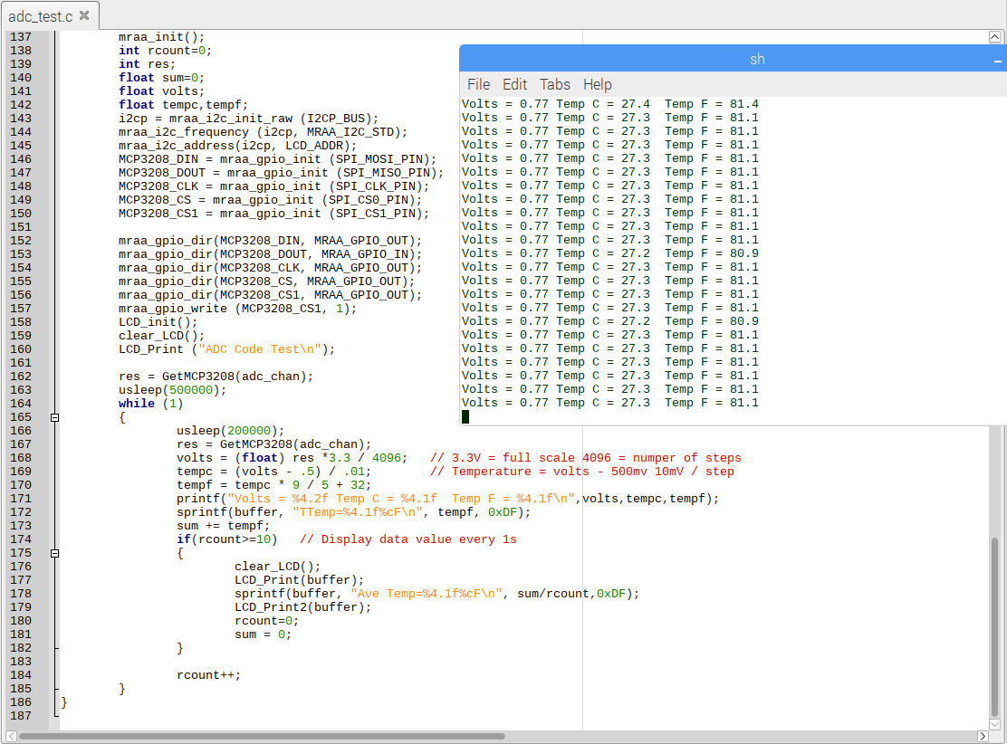
Open adc_test.c with Geany, compile, link, and run

Slide 39
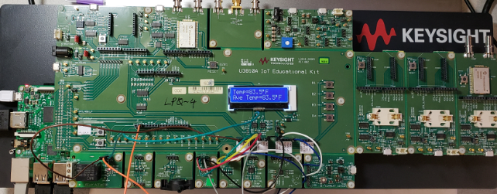
Explore and Hack with the code and sensors
Make the Pressure Sensor display on the LCD
Make a settable thermostat using the buttons, thermo sensor and relay.
Make a Temp and Barometer display with Rising / Falling pressure.

Slide 40
Thanks !!! Have Fun With Raspberry Pi

